Slide 1


Animals in Antiquity
Library Exhibition at the Center for Hellenic Studies

Slide 2
Animals in ancient Egypt were worshipped as deities, Anubis, a dog, Horus, a falcon, Bastet, a cat,
Sekhmet, a lion, Toth, a baboon and ibis. In ancient Greece they were the companions or
theomorphic stand-ins for gods and goddesses such as Athena and her owl, Hera and her
peacock, Artemis and her deer, and Aphrodite and her swan. Many animals were considered
sacred such as snakes in the worship of Apollo, Dionysus, and Asclepius, pigs in the cult of Demeter,
bees and bears in the cult of Artemis.
Before the invention of weapons, our human ancestors were themselves hunted as easy prey
animals without fangs and claws to defend themselves and with limited ability to run, jump, and
climb. Eventually, with the invention of spears and arrows the tables turned and humans began
to hunt other animal species; however, meat, contrary to the stereotypical image of the “cave
man,” constituted a very small portion of the prehistoric diet. Most of the food was collected by
so called gatherers, often women, who collected roots, nuts, seeds, grains, wild mushrooms, wild
olives, wild figs, and other wild seeds, fruits and berries. The killed animals, rather than being eaten,
may originally have been offered to please or plead with the gods, a custom that continued in
ancient Greece and Rome (ca. 1400 BCE-4th century CE). No animal in pagan antiquity was
killed strictly for food. The meat was shared by humans and their gods to whom the animals had
been sacrificed on special occasions such as religious festivals, which in ancient Greece often
included theater/music and athletic competitions, such as at the City Dionysia and the Olympic
Games, all to honor particular gods and goddesses.

Slide 3
As human animals went from a nomadic existence to one of settlers and farmers, they began taming and
using other animals for their own purposes. After their domestication, bulls, cows, horses, donkeys, pigs,
sheep, and goats were used to plow fields, to provide milk, transportation, and clothing. Wild boars were
hunted for “displays of manhood” by well-to-do young men as were various birds, deer, hares, and even
lizards. Some animals were made companions or pets such as sparrows, pigeons, doves, dogs, cats,
monkeys and even such wild animals as gazelles and cheetahs.
Rabbits, dogs, roosters, and doves were given as presents, also in courtship as “love gifts.” Mice and various
kinds of fish were eaten, but they, too could be pets and sacred to the gods. Animals including horses and
elephants were used in war, and as entertainment in ancient Rome where lions, tigers, elephants, giraffes,
bears, rhinoceroses, hippopotamuses, wild donkeys, hyenas, and ostriches were forced to fight to their
deaths.
Greek authors, including Plato, Aristotle, Plutarch, Aelian, and Porphyry, wrote about animals in
works on ethics, morals, and natural history. Prose and poetry writers and historians, including Homer,
“Aesop”, Herodotus, Lucretius, Oppian, Ovid, Diodorus Siculus, and Dio Cassius, used animals to tell stories
and to illustrate the human experience.

Slide 4
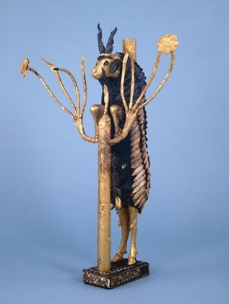
One of the earliest animals to be domesticated in the Near East was the goat, judging from evidence from Neolithic
(later Stone Age) Jericho ca. 7000-6000 BCE. Neolithic farmers began to herd wild goats for milk and wool.
Their browsing was also useful to clear away brush for planting and to prevent fires. Their dung was used as fuel and
building material.
The famous “Billy Goat in a Thicket” from Sumer, Near East, ca. 2600 BCE. Made from gold leaves and lapis lazuli.
British Museum.

Slide 5
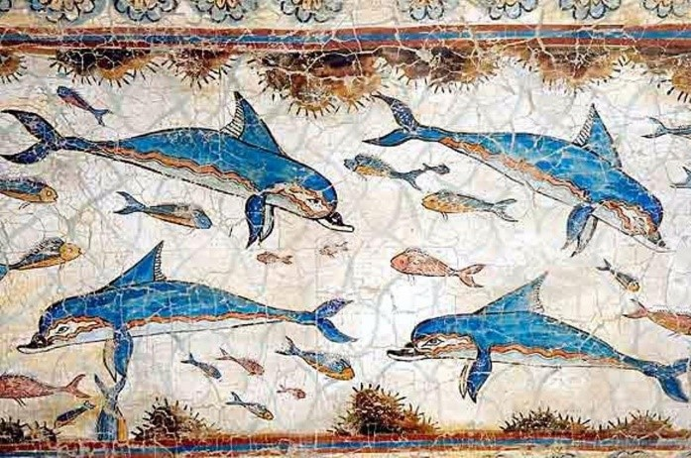
Animals in Art
There are numerous images of animals in antiquity on pottery, in frescoes, on coins, on temples,
in figurines and sculptures. This is one of the most famous and beautiful depictions of dolphins in antiquity.
A pod of dolphins on a Minoan fresco from the so called Queen’s Megaron, Knossos, ca. 1500 BCE.
The Minoans (a Bronze Age civilization ca. 2700-1400 BCE on Crete and surrounding islands) displayed a
remarkable sense of movement and delicate elegance in their art, especially when depicting nature
scenes as in the “Blue Monkey” fresco from Thera (Santorini). Colors seem to have had special meaning
to the Minoans, including the color blue.

Slide 6
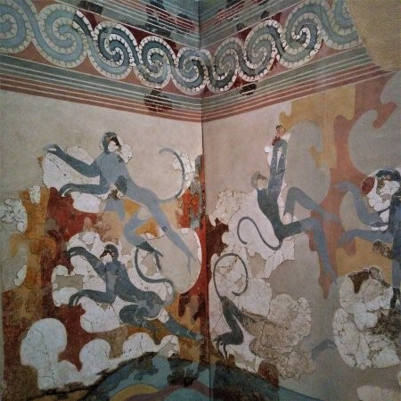
“Blue Monkey” fresco. Thera (Santorini). Room Beta 6. West Wall, ca. 1500 BCE.
Both Minoan women (painted white) and men (painted red-brown) participated in acrobatic
“performances,” which involved jumping over bulls. The bulls, however, were not killed as in
contemporary Spanish bullfights but were sacred to the Minoans.

Slide 7
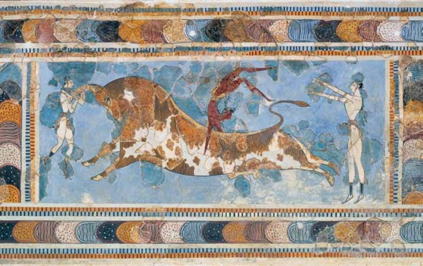
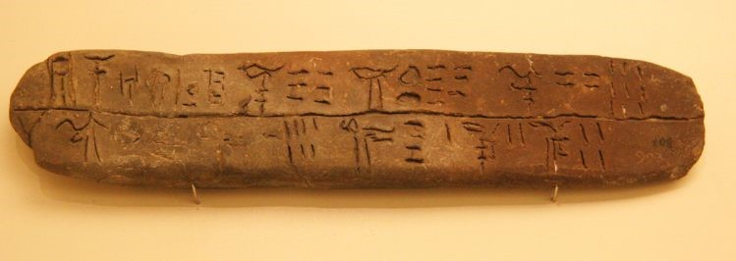
The “Bull-leaping” fresco from the East Wing of the “Palace” of Knossos, ca. 1600-1400 BCE.
That animals were used in farming by the early Greeks is witnessed by texts on clay tablets from the
Mycenaean civilization (ca. 1400-1100 BCE), written in the earliest form of Greek, the so called Linear
B script. This tablet was discovered at Knossos on Crete and mentions goats, boars, cows, and bulls.
Dated to ca. 1400 BCE.

Slide 8
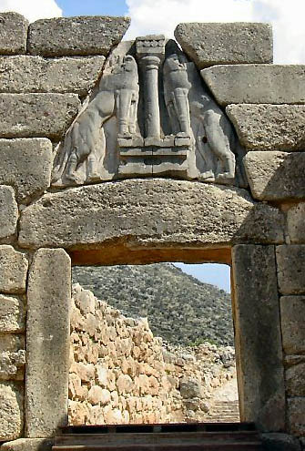
The “Lion Gate” leading to the citadel of Mycenae on the Peloponnese is the most recognizable
monumental artwork of the early Greek Mycenaean civilization, ca. 1250 BCE.
“Exotic” animals such as lions, leopards, and panthers were popular as illustrations in Greek art,
especially on Greek pottery during the so called Archaic/Orientalizing period (ca. 8-6th century
BCE) when Corinth on the Peloponnese was a wealthy production and trading center.

Slide 9
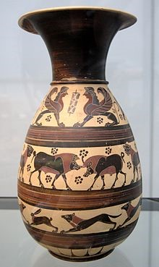
Orientalizing Corinthian oinochoe (wine jug) featuring sphinxes, lions, panthers, ca. 620 BCE. Glyptothek,
Munich.
“Grotesques” and “Bestiaries”: Book Art in the Middle Ages
Animals decorated all sorts of texts during the European Middle Ages (ca. 1100-1453 CE) which to a
large extent continued the ancient conventions in art and literature but now as marginal fillers or moral
lessons rather than as gods or sacred animals with a few possible exceptions such as the dove for the
Holy Ghost, the lamb of Jesus Christ, and the three animal symbols (ox, lion, eagle) of the Evangelists.
The margins of illuminated medieval manuscripts were frequently filled with every kind of animal, real
and imagined. In fact, a technical term for marginal illuminations or “grotesques” is Baboon or
Baboyne or Babewyne. Although most colors used were plant based, the red pigment was usually
made from the blood of various insects. The pages of medieval manuscripts were made from the
skin of animals, mostly from calves, sheep, and goats.

Slide 10
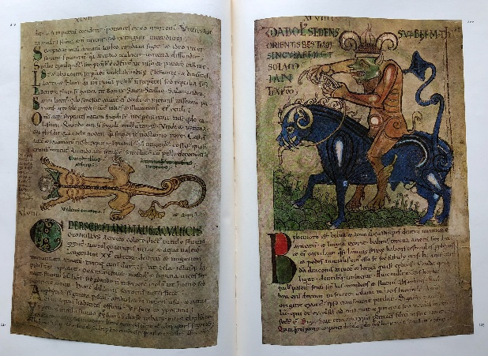
So called bestiaries were one of the most popular medieval literary genres. A bestiary was an illustrated
codex describing various animals and plants usually accompanied by a moral lesson after the
example of Aesop’s Fables from antiquity.
Lizard-leopard and horse-ram-boar composite animals. Liber Floridus (“Flower Book”) is a medieval
encyclopedia about plants and animals, in part a “Bestiary,” compiled between 1090 and 1120 CE
by Lambert, Canon of Saint-Omer. The manuscript is in the Library of the University of Ghent.

Slide 11
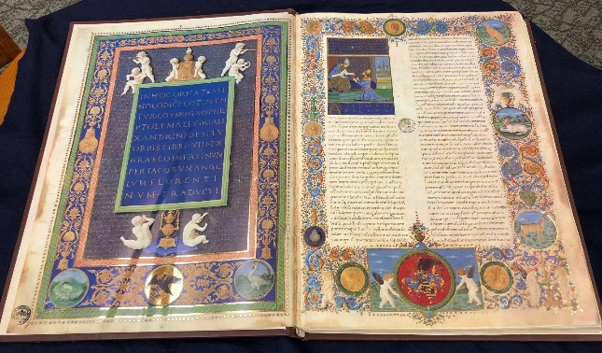
In this rare facsimile (Cod. Urb. lat. 277) of the Latin translation by Jacopo D’Angelo from 1409 of an
atlas by Ptolemy from the 2nd century CE, animals — leopard, dog, deer, goose(?), eagle, ermine,
etc. – in the marginal illustrations abound. Facsimile in the CHS Library. The original manuscript is at
the Vatican.
The distinction between nature, nonhuman animals, and humans, which characterizes
monotheistic religions such as Christianity, was not as sharply drawn among the ancient pagans.
The animals featured could be hybrid “fantasy” animals such as the Centaur (horse-man),
Sphinx (lion-woman), Hippocamp (fish-horse), Minotaur (bull-man), Griffin (eagle-lion),
Typhon (snake-man), Medusa (snake-woman), and Chimaera (lion-goat-snake).

Slide 12
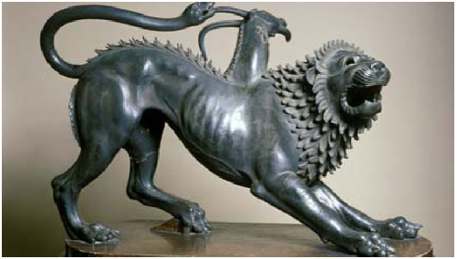
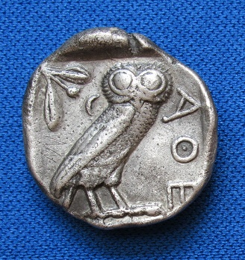
The Chimaera. Etruscan bronze sculpture from Arezzo, ca. 400 BCE. National Archaeological
Museum of Florence.
Animals as Iconographic Symbols
The goddess Athena was the patron deity of the city-state of Athens, and its coins usually depicted
the goddess on one side and her owl on the other.
Owl on an Athenian silver tetradrachm, ca. 449-404 BCE. The CHS Library.

Slide 13
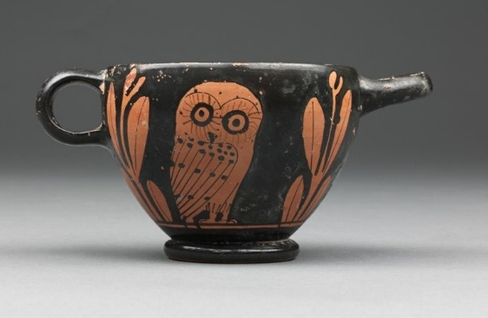
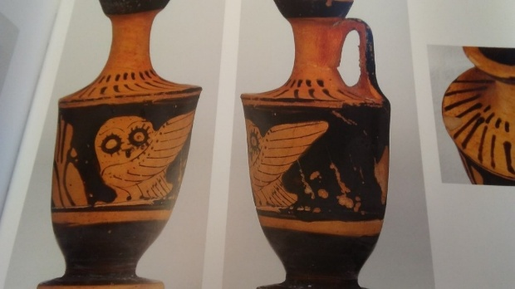
Owl on an Attic skyphos (wine cup), second quarter of 5th century BCE. National Gallery of Victoria,
Melbourne.
The Athenian owl on a red-figure lekythos (oil container) from Nola, Southern Italy, ca. 4th century
BCE. (Staatliche Museen zu Berlin) Antikensammlung, Berlin.
Many of the Greek city states, besides Athens, had animals (and deities) as symbols, for example:

Slide 14
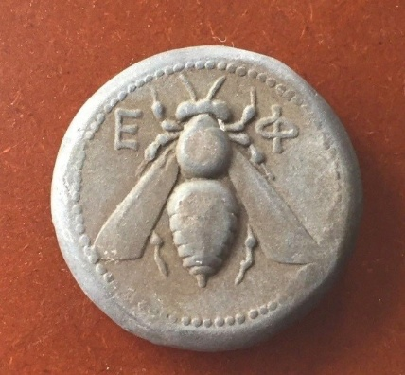
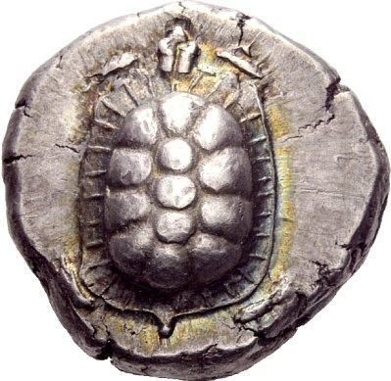
Ephesus and its bee sacred to Artemis on a silver tetradrachm, ca. 350-340 BCE.
Aegina and its turtle. Silver stater, ca. 445-431 BCE.

Slide 15
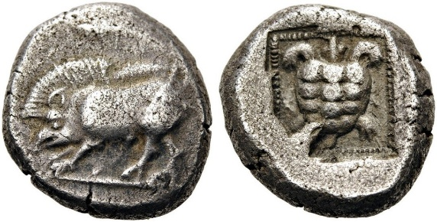
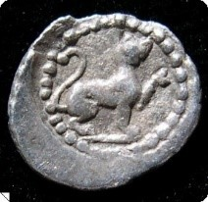
Lycia (in modern-day Turkey) and its boar and tortoise. Silver stater, ca. 490-430 BCE.
Lycia could also be represented by a panther or leopard as on this silver hemiobol, ca. 400-390 BCE.

Slide 16
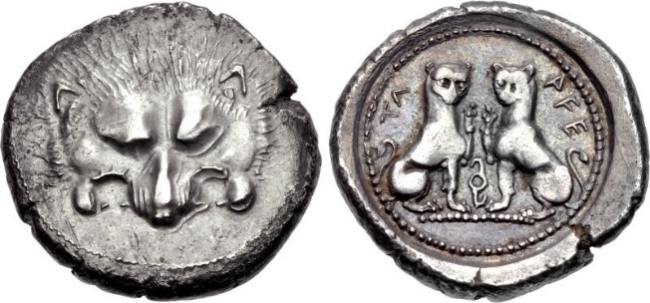
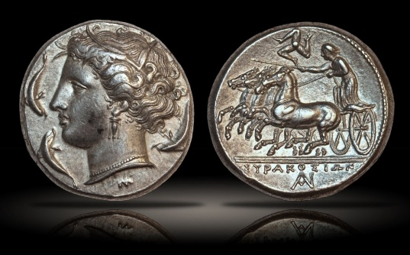
This coin featuring twin panthers or leopards along with a lion on the reverse is also from Lycia. Silver
stater, ca. 450-380 BCE. Most figures in ancient art were portrayed in profile, so when they appear
with frontal faces as here and as the panther/leopard on the hemiobol, it is thought that they served
an apotropaic function, i.e., to ward off evil spirits or bad luck. It could perhaps also be an artistic
attempt at breaking with convention.
Syracuse, Sicily, and its nymph goddess Arethusa surrounded by dolphins. Silver tetradrachm,
ca. 310 BCE.

Slide 17
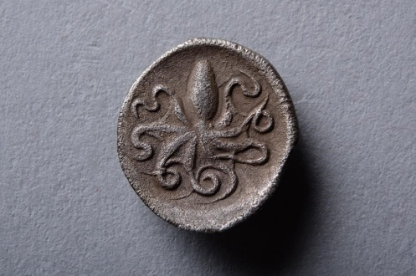
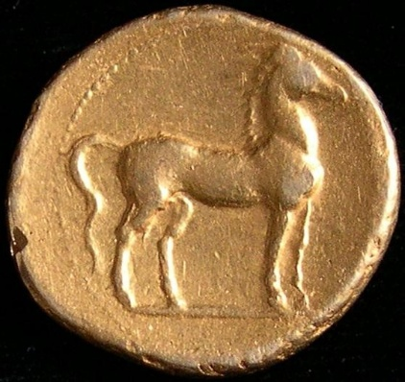
Syracuse could also be represented by an octopus as on this Greek silver litra, ca. 466-405 BCE.
Carthage (present-day Tunisia, North Africa) by a horse as on this electrum stater, ca. 310-290 BCE.

Slide 18
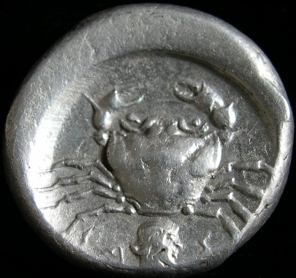
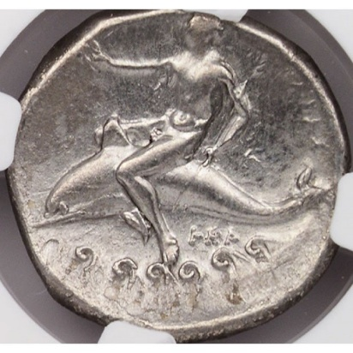
Akragas (modern Agrigento, Sicily) by a crab as on this silver didrachm, ca. 495-478 BCE.
Tarentum (modern Taranto, Calabria) by its eponymous founder Taras riding a dolphin. Silver didrachm,
ca. 3rd century BCE.
There were many tales in antiquity of people being rescued by dolphins such as Arion, the purported
inventor of the dithyramb, which, according to Greek philosopher Aristotle, was the origin of Greek
tragedy, who after being kidnapped by pirates escaped on the back of a dolphin or so the story goes.

Slide 19
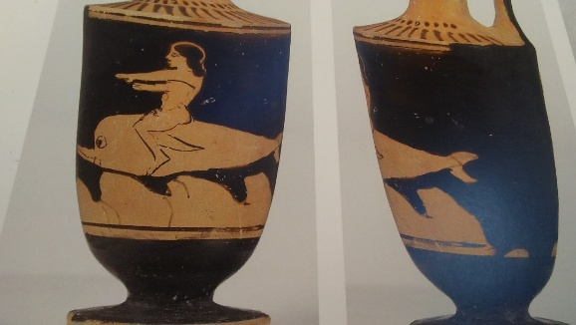
Attic red-figure lekythos with a young man riding on a dolphin, ca. 500-450 BCE. (Staatliche Museen
zu Berlin) Antikensammlung, Berlin.
The famous cult statue of Artemis and her temple at Ephesus, now in modern-day Turkey, were
counted among the Seven Wonders of the ancient world. The statue is full of animals — on the
goddess’ dress, headgear, and sandals. The identification of the bulbous protrusions in the front has
been hotly debated. The most logical interpretation is of the Goddess of Nature nursing all her
children – animals and plants alike — or possibly seeds to feed life. The temple’s beehive
organization with priestesses called bees and priests drones may point to a representation of eggs.
A wildly speculative and nonsensical theory is that they represent bull scrota.

Slide 20
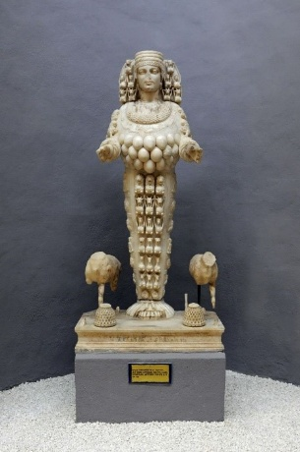
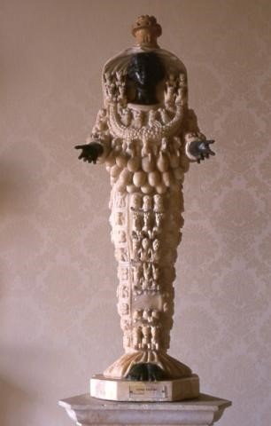
A replica of the cult statue of Ephesian Artemis in the Museum of Ephesus. The earliest temple and
statue date back to the Bronze Age although this copy is dated much later. Christians eventually
destroyed the temple and statue in the 5th century CE.
Artemis of Ephesus worshiped “in Asia and all the world.” A Roman copy of an original from the
2nd century BCE. Capitoline Museums, Rome.

Slide 21
Ritual Sacrifice of Animals
The sacrifice of animals to various deities was quite common although not as frequent as Christians
would later contend. It was generally limited to large official and formal religious ceremonies. Most
everyday offerings were in the form of libations and fruits, seeds, and nuts. Some ancient Greeks
and Romans as well as modern scholars have theorized that animal sacrifice had its origin in human
sacrifice to placate a deity in times of extreme danger such as during an earthquake, war, or famine.
If this was so, it is unclear how and when it became more “commonplace” or when nonhuman animals
were substituted for human.
The most famous human sacrifice in classical antiquity was that of the virgin Iphigenia, the daughter of
Agamemnon, one of the Greek kings from the Trojan War. Although there are different versions of the
ending, one of the most popular was told by the Greek playwright Euripides (ca. 480–ca. 406 BCE) who
had the goddess Artemis, to whom the sacrifice had been offered in the first place, substitute the
human girl for a deer, which perhaps could be interpreted as an allegory for an actual development
from human to animal sacrifice. There are many references to human sacrifice in Greek literature and
archaeological evidence pointing to such sacrifice has been unearthed in various places on
Minoan-Mycenaean Crete (Myrtos, Knossos, Archanes, Chania) and at Etruscan Tarquinia.

Slide 22
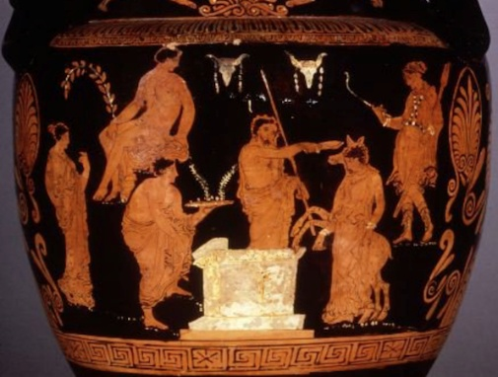
Iphigenia at the moment of substitution for a deer. Volute crater, ca. 370-355 BCE. British Museum.
Animals as Entertainment
Roman historian (of Greek origin and writing in Greek) Dio Cassius (ca. 155-235 CE) describes the
slaughter of wild animals as theater:
Hippos, Rhinos, Elephants
“[Roman Emperor] Commodus devoted most of his life to ease and to horses and to combats of
wild beasts and of men. In fact, besides all that he did in private, he often slew in public large
numbers of men and of beasts as well. For example, all alone with his own hands, he dispatched
five hippopotami together with two elephants on two successive days; and he also killed
rhinoceroses and a camelopard” (Dio Cassius, Roman History 73.10.3).

Slide 23
200 lions
“On his birthday he [Emperor Hadrian] gave the usual spectacle free to the people and slew many
wild beasts, so that one hundred lions, for example, and a like number of lionesses fell on this single
occasion” (Dio Cassius, Roman History 69.8.1).
500 lions, 18 elephants and human deception
“During these same days Pompey dedicated the theatre in which we take pride even at the present
time. In it he provided entertainment consisting of music and gymnastic contests and in the Circus a
horse-race and the slaughter of many wild beasts of all kinds. Indeed, five hundred lions were used up
in five days, and eighteen elephants fought against men in heavy armor. Some of these beasts were
killed at the time and others a little later. For some of them, contrary to Pompey’s wish, were pitied by
the people when, after being wounded and ceasing to fight, they walked about with their trunks raised
toward heaven, lamenting so bitterly as to give rise to the report that they did so not by mere chance,
but were crying out against the oaths in which they had trusted when they crossed over from Africa, and
were calling upon Heaven to avenge them. For it is said that they would not set foot upon the ships
before they received a pledge under oath from their drivers that they should suffer no harm”
(Dio Cassius, Roman History 38).

Slide 24
700 wild boars, elephants, hyena, ostriches, bison, panthers, wild asses
“At these spectacles [10th anniversary of Emperor Severus’ power] sixty wild boars of Plautianus fought
together at a signal and among many other wild beasts that were slain were an elephant and a
corocotta [hyena]. This last animal s an Indian species and was then introduced into Rome for the first
time, so far as I am aware. It has the color of a lioness and tiger combined, and the general
appearance of those animals, as also of a dog and a fox, curiously blended. The entire receptacle in
the amphitheater had been constructed so as to resemble a boat in shape, and was capable of
receiving or discharging four hundred beasts at once; and then, as it suddenly fell apart, there came
rushing forth bears, lionesses, panthers, lions, ostriches, wild asses, bison (this is a kind of cattle foreign
in species and appearance), so that seven hundred beasts in all, both wild and domesticated, at one
and the same time were seen running about and were slaughtered” (Dio Cassius, Roman History 77).

Slide 25
Greek historian Diodorus Siculus (ca. 96-30 BCE) tells the story of Alexander the Great administering a fight
between dogs and a lion:
“To Alexander he presented many impressive gifts, among them one hundred and fifty dogs remarkable
for their size and courage and other good qualities. People said that they had a strain of tiger blood. He
wanted Alexander to test their mettle in action, and he brought into a ring a full-grown lion and two of
the poorest of the dogs. He set these on the lion, and when they were having a hard time of it, he
released two others to assist them. The four were getting the upper hand over the lion when Sopeithes
sent in a man with a scimitar who hacked at the right leg of one of the dogs. At this Alexander shouted
out indignantly and the guards rushed up and seized the arm of the Indian, but Sopeithes said that
he would give him three other dogs for that one, and the handler, taking a firm grip on the leg,
severed it slowly. The dog, in the meanwhile, uttered neither yelp nor whimper, but continued with
his teeth clamped shut until, fainting with loss of blood, died on top of the lion” (Diodorus Siculus 17.92).

Slide 26
Animals in War
Not only horses were used in war, but also elephants as famously witnessed by the Battle of Cannae in
southeast Italy in 216 BCE between Carthage and Rome where the Carthaginian leader Hannibal won
probably in no small measure due to his use of elephants, a sight that terrified the Roman soldiers
(and, no doubt, the gentle elephants would have been terrified as well).
Greek historian Polybius (ca. 200-118 BCE) describes the wading of a river in the Italian Alps by elephants:
“The animals were always accustomed to obey their mahouts up to the water, but would never enter it
on any account, and they now drove them along over the earth with two females in front, whom they
obediently followed. As soon as they set foot on the last rafts the ropes which held these fast to the
others were cut, and the boats pulling taut, the towing lines rapidly tugged away from the pile of earth
the elephants and the rafts on which they stood. Hereupon the animals becoming very alarmed at first
turned round and ran about in all directions, but as they were shut in on all sides by the stream they
finally grew afraid and were compelled to keep quiet. In this manner, by continuing to attach two rafts
to the end of the structure, they managed to get most of them over on these, but some were so
frightened that they threw themselves into the river when halfway across. The mahouts of these were
all drowned, but the elephants were saved, for owing to the power and length of their trunks they kept
them above the water and breathed through them, at the same time spouting out any water that got
into their mouths and so held out, most of them passing through the water on their feet” (Polybius 3.46).

Slide 27
Animals as Food
In ancient Greece, only animals sacrificed to the gods could be eaten after a portion of the animal
was given to a particular deity or deities. The everyday staple foods of the ordinary Greek were mainly
plant based. However, some Greeks objected to the eating of meat at all. Greek biographer and
essayist Plutarch’s (46-120 CE) philosophical dialogue “On the Eating of Flesh” in a series of essays
entitled Moralia makes a strong case for vegetarianism.
Greek essayist Plutarch’s (46-120 CE) case for vegetarianism:
“Can you really ask what reason Pythagoras had for abstaining from flesh? For my part I rather
wonder both by what accident and in what state of soul or mind the first man who did so, touched
his mouth to gore and brought his lips to the flesh of a dead creature, he who set forth tables of dead,
stale bodies and ventured to call food and nourishment the parts that had a little before bellowed
and cried, moved and lived. How could his eyes endure the slaughter when throats were slit and
hides flayed and limbs torn from limb? How could his nose endure the stench?” (993a-b).

Slide 28
“When we had tasted and eaten acorns we danced for joy around some oak, calling it “life-giving”
and “mother” and “nurse.” “…Why slander the earth by implying that she cannot support you?” (994f).
“Are you not ashamed to mingle domestic crops with blood and gore? You call serpents and panthers
and lions savage, but you yourselves, by your own foul slaughters, leave them no room to outdo you in
cruelty; for their slaughter is their living, yours is a mere appetizer” (994a-b).
“But nothing abashed us, not the flower-like tinting of the flesh, not the persuasiveness of the harmonious
voice, not the cleanliness of their habits or the unusual intelligence that may be found in the poor
wretches. No, for the sake of a little flesh we deprive them of sun, of light, of the duration of life to which
they are entitled by birth and being. Then we go on to assume that when they utter cries and squeaks
their speech is inarticulate, that they do not, begging for mercy, entreating, seeking justice…” (994e).
“What a terrible thing it is to look on when the tables of the rich are spread, men who employ cooks
and spices to groom the dead! And it is even more terrible to look on when they are taken away, for
more is left than has been eaten. So the animals died for nothing!” (994f).

Slide 29
“…it is absurd for them to say that the practice of flesh-eating is based on Nature. For that man is not
naturally carnivorous is, in the first place, obvious from the structure of his body. A man’s frame is in no
way similar to those creatures that were made for flesh-eating: he has no hooked beak or sharp nails or
jagged teeth, no strong stomach or warmth of vital fluids able to digest and assimilate a heavy diet of
flesh. It is from this very fact, the evenness of our teeth, the smallness of our mouths, the softness of our
tongues, our possession of vital fluids too inert to digest meat that Nature disavows our eating of flesh”
(994f-995a).
“If you declare that you are naturally designed for such a diet, then first kill for yourself what you want
to eat. Do it, however, only through your own resources …just as wolves and bears and lions themselves
slay what they eat, so you are to fell an ox with your fangs or a boar with your jaws or tear a lamb or
hare in bits. Fall upon it and eat it still living, as animals do” (995a-b).
“…Even when it is lifeless and dead, however, no one eats the flesh just as it is; men boil it and roast it,
altering it by fire and drugs, recasting and diverting and smothering with countless condiments the taste
of gore so that the palate may be deceived and accept what is foreign to it” (995b).

Slide 30
Another vegetarian was Pythagoras (ca. 570–495 BCE), the Greek philosopher and mathematician.
The Roman poet Ovid (43 BCE–17/18 CE) in his poem the Metamorphoses gave voice to his position on
meat-eating. The passion of Ovid’s narrative makes it tempting to think that it reflects also his own
sentiments on the subject. Moreover, the Metamorphoses contain many stories of humans transformed
into animals (and sometimes vice versa) such as Alcaeus into a deer and Callisto into a bear, often
exhibiting empathy with the animal.
Roman poet Ovid (43 BCE-17/18 CE) on Pythagoras’s vegetarianism:
“He [Pythagoras] was the first to decry the placing of animal food upon our tables. His lips learned
indeed but not believed in this, he was the first to open in such words as these:” (15.73-75)
“O mortals, do not pollute your bodies with a food so impious! You have the fruits of the earth, you
have apples, bending down the branches with their weight, and grapes swelling to ripeness on the
vines; you have also delicious herbs and vegetables…” (15.75-78).
“The earth, prodigal of her wealth, supplies you her kindly sustenance and offers you food without
bloodshed and slaughter” (15.81-82).

Slide 31
”But that pristine age, which we have named the golden age” (15.96-97) “…All things were free from
treacherous snares, fearing no guile and full of peace. But after someone, an ill exemplar, whoever he
was, envied the food of lions, and thrust down flesh as food into his greedy stomach, he opened the
way for crime” (15.102-103).
“Further impiety grew out of that, and it is thought that the sow was first condemned to death as a
sacrificial victim because with her broad snout she had rooted up the planted seeds and cut off the
season’s promised crop. The goat is held fit for sacrifice at the avenging altars because he had browsed
the grape-vines” (15.111-115).
“…But, ye sheep, what did you ever do to merit death, a peaceful flock…that bring us sweet milk to
drink in your full udders, who give us your wool for soft clothing, and who help more by your life than
by your death? What have the oxen done, those faithful, guileless beasts, harmless and simple, born to
a life of toil?” (15.116-121).

Slide 32
“Nor is it enough that we commit such infamy: they made the gods themselves partners of their
crime and they affected to believe that the heavenly ones took pleasure in the blood of the toiling
bullock! A victim without blemish and of perfect form (for beauty proves his bane), marked off with
fillets and with gilded horns, is set before the altar, hears the priest’s prayer, not knowing what it
means, watches the barley-meal sprinkled between his horns, barley which he himself labored to
produce, and then, smitten to his death, he stains with his blood the knife which he has perchance
already seen reflected in the clear pool. Straightway they tear his entrails from his living breast,
view them with care, and seek to find revealed in them the purposes of heaven” (15.127-137).
“…when you take the flesh of slaughtered cattle in your mouths, know and realize that you are
devouring your own fellow-laborers” (15.141-142).

Slide 33
The Greek Neo-Platonic philosopher Porphyry (ca. 234-305 CE) on veganism:
“If…someone should…think it is unjust to destroy brutes, such a one should neither use milk, nor wool, nor
sheep, nor honey. For, as you injure a man by taking from him his garments, thus, also, you injure a sheep
by shearing it. For the wool which you take from it is its vestment. Milk, likewise, was not produced for you,
but for the young of the animal that has it. The bee also collects honey as food for itself; which you, by
taking away, administer for your own pleasure” (Porphyry, On Abstinence 1.21).
Animals as Companions/Pets
Companion animals or pets were popular also in antiquity, especially dogs and cats, but among the
Egyptians also baboons, various kinds of monkeys, fish, gazelles, birds, lions, mongoose, hippos, etc.,
and among the Greeks and Romans, apart from cats and dogs also rabbits, snakes, doves, herons,
cranes, chickens, ducks, geese, magpies, quails, peacocks, pigeons, parrots, nightingales, and other
birds, and, among wealthy Romans, possibly even deer, cheetahs, leopards, and lions.

Slide 34
Dogs
Probably the most famous dog in ancient Greece was Argus, the loyal and faithful dog that recognizes
his disguised guardian, the long-lost Greek hero from the Trojan War, Odysseus, in the Homeric epic the
Odyssey (8th century BCE) whereupon he dies. Knowing that his guardian was alive and well after being
gone for some twenty years allowed the ailing and aged dog Argus to finally give up the ghost.
Legendary Greek poet Homer (8th century BCE) tells the story about the dog Argus:
“There lay the dog Argus, full of dog ticks. But now, when he became aware that Odysseus was near,
he wagged his tail and dropped both ears, but nearer to his master he had no longer strength to move.
Then Odysseus looked aside and wiped away a tear, easily hiding from Eumaeus what he did; and
immediately he questioned him, and said: Eumaeus, truly it is strange that this dog lies here in the dung.
He is fine of form, but I do not clearly know whether he had speed of foot to match this beauty or
whether he is merely as table dogs are, which their masters keep for show” (Homer, Odyssey 17. 290-327).
“To him then, swineherd Eumaeus, did you make answer and say: “Yes, truly this is the dog of a man
who has died in a far land. If he were but in form and action such as he was when Odysseus left him
and went to Troy, you would soon be amazed at seeing his speed and his strength…”
(Homer, Odyssey 17. 290-327).
“…But as for Argus, the fate of black death seized him once he had seen Odysseus in the twentieth year”
(Homer, Odyssey 17. 326-27).

Slide 35
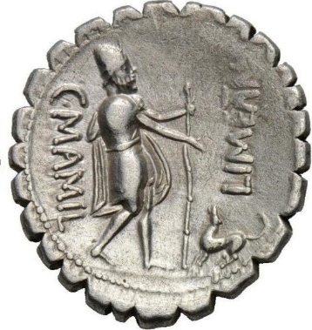
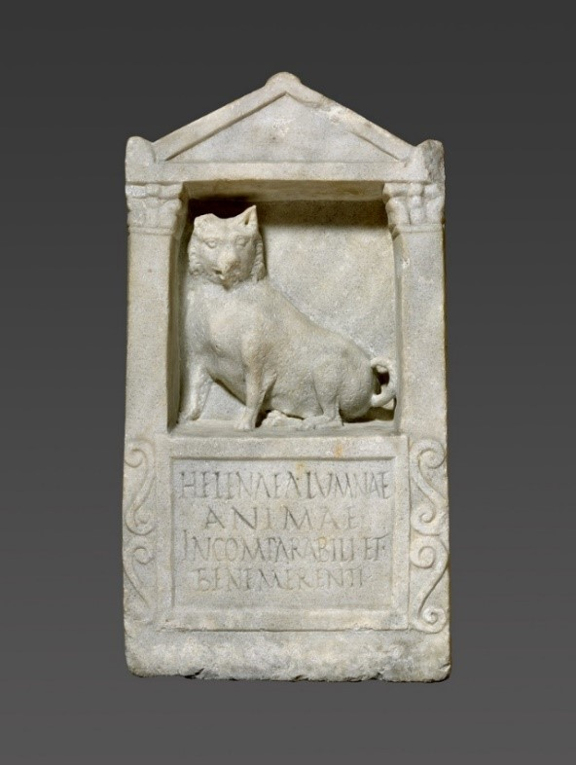
The dog Argus on a silver denarius, 82 BCE. This image of a young and energetic Argus does not
correspond well with the portrait of the old and sick dog from the Odyssey.
Pet burials with tomb stones were not uncommon, especially in Rome where, for example, a
tombstone with a sculpted dog holds an epitaph to a dog named Helena, dated to 150-200 CE,
now at the Getty Villa in Los Angeles. The Latin inscription reads: “To Helena, foster daughter,
incomparable and trustworthy soul.”

Slide 36
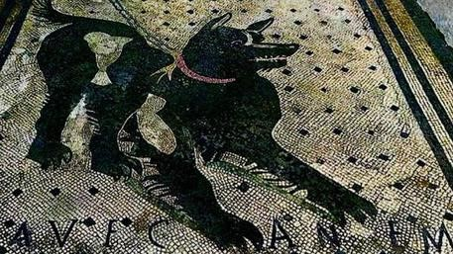
We read that an Athenian named Poliarch was so attached to his pets that if a pet dog or rooster
died, he held public funerals to which his friends were invited, and he had inscribed tombstones
erected to them.
“They say that Poliarchus the Athenian arrived at so great a height of Luxury, that he caused those
dogs and cocks which he had loved, being dead, to be carried out solemnly, and invited friends to
their Funerals, and buried them splendidly, erecting Columns over them, on which were engraved
Epitaphs” (Aelian, Various Histories 8.4).
Just like today’s homeowners, the ancients also used dogs for protection. This mosaic from Pompeii
depicts a chained guard dog with the inscription Cave Canem (Be aware of the dog), terminus ante
quem 79 CE.

Slide 37
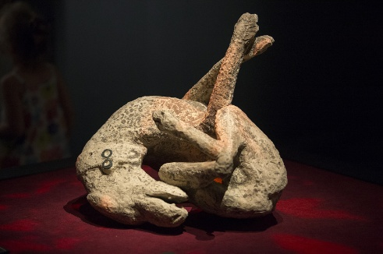
Probably the saddest but also most famous image of a dog from antiquity is the guard dog who
because it was chained could not escape the ashes of the volcanic eruption of Vesuvius that buried
the town of Pompeii in 79 CE and so died in agony.
Cats
Cats are generally believed to have been domesticated in ancient Egypt some 4,000 years ago;
however, evidence suggests that the cat may have been part of the household in the Near East
already some 14,000 years ago along with sheep, goats, and dogs.
Cats and lions were sacred in ancient Egypt. There was even a cat goddess, Bastet. They were used
both as pets and mousers. Many cat owners had their cats mummified to accompany them in death,
although mummified cats and cat figurines were mostly given as offerings to the immensely popular
cat goddess at her temple in Bubastis (Tell Basta), where amulets and votive figurines of the goddess
were mass produced and festivals with wine, song and dance in her honor were held.

Slide 38
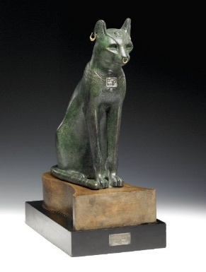
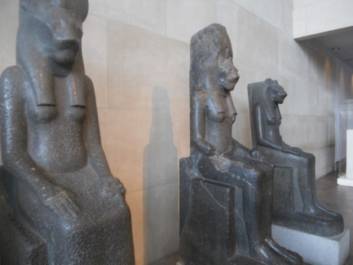
The so called Gayer-Anderson Cat (the cat goddess Bastet) from Ancient Egypt, Late Period ca.
664-332 BCE. Made of bronze with gold ornaments. British Museum.
The lion goddess Sekhmet, ca. 1390-1352 BCE. Metropolitan Museum of Art.

Slide 39
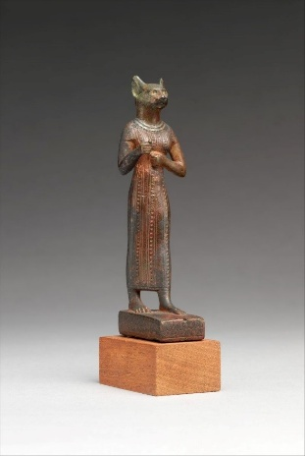
Egyptian cat goddess Bastet, ca. 664-30 BCE. Made of leaded bronze. Metropolitan Museum of Art.
Greek historian Herodotus (ca. 484-425 BCE) on the festival of the cat goddess:
“…when they have reached Bubastis, they make a festival with great sacrifices, and more wine is
drunk at this feast than in the whole year beside. Men and women (but not children) are wont to
assemble there to the number of seven hundred thousand, as the people of the place say”
(Herodotus 2.60).
The ancient Egyptians believed in life after death. Literally, thousands of cat mummies have been
excavated in Egypt. However, many also felt bad about killing cats for mummification so many of the
many cat mummies found in Egyptian tombs and temples are actually fake. In fact, the penalty for
killing a cat in Egypt, even by accident, was death. The export of cats from Egypt was so strictly
prohibited that government agents were dispatched to other lands to find and return cats which
had been smuggled out. This speaks to the extraordinary high regard for cats in ancient Egypt.

Slide 40
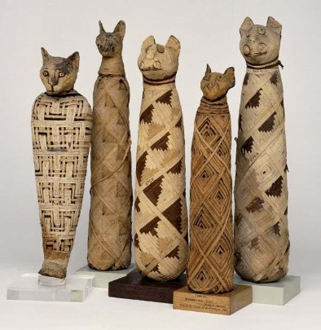
Diodorus Siculus on embalming cats:
“When one of these animals dies, they wrap it in fine linen and then, wailing and beating their breasts,
carry it off to be embalmed; and after it has been treated with cedar oil and such spices as have the
quality of imparting a pleasant odor and of preserving the body for a long time, they lay it away in
a consecrated tomb” (1.83.5-6).
Numerous cat mummies were found in the desert at Beni Hassan, about a hundred miles from Cairo
in the late 1800s. Most were sold on the private antiquities market.

Slide 41
The death penalty for killing a cat
“And whoever intentionally kills one of these animals is put to death, unless it be a cat or an ibis that
he kills; if he kills one of these [cats], whether intentionally or unintentionally, he is certainly put to
death, for the common people gather in crowds and deal with the perpetrator most cruelly,
sometimes doing this without waiting for a trial. And because of their fear of such a punishment
any who have caught sight of one of these animals lying dead withdraw to a great distance and
shout with lamentations and protestations that they found the animal already dead. So deeply
implanted also in the hearts of the common people is their superstitious regard for these animals and
so unalterable are the emotions cherished by every man regarding the honor due to them that once,
at the time when Ptolemy their king had not as yet been given by the Romans the appellation of
“friend” and the people were exercising all zeal in courting the favor of the embassy from Italy which
was then visiting Egypt and, in their fear, were intent upon giving no cause for complaint or war,
when one of the Romans killed a cat and the multitude rushed in a crowd to his house, neither the
officials sent by the king to beg the man off nor the fear of Rome which all the people felt were
enough to save the man from punishment, even though his act had been an accident. And this
incident we relate, not from hearsay, but we saw it with our own eyes on the occasion of the visit
we made to Egypt” (Diodorus Siculus 1.83.1-8).

Slide 42
A telling and frightening story is that of the Persian army led by Cambyses II at the Battle of Pelusium in
525 BCE. The Persians used the Egyptian veneration for cats and other animals against them by in
addition to painting cats on their shields, also placing dogs, sheep, ibises, and especially cats in the
front lines of the battle configuration which prevented the Egyptians from defending themselves
because of their concern for the animals’ safety, which ultimately led to Egypt being conquered.
Greek historian Herodotus, writing about the Egyptian veneration for cats, explains that when a cat
dies a natural death, all who dwell in the house of that cat shave their eyebrows to express their sorrow.
The time of mourning ends only when the eyebrows grow back.
Herodotus on mourning cats:
“And when a fire breaks out very strange things happen to the cats. The Egyptians stand round in
a broken line, thinking more of the cats than of quenching the burning; but the cats slip through or
leap over the men and spring into the fire. When this happens, there is great mourning in Egypt.
Dwellers in a house where a cat has died a natural death shave their eyebrows and no more; where
a dog has so died, the head and the whole body are shaven” (Herodotus 2.66-2.67).

Slide 43
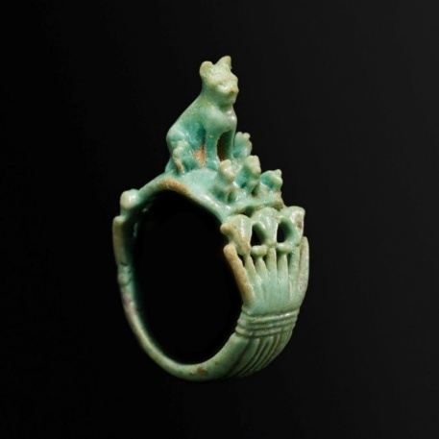
“Dead cats are taken away into sacred buildings, where they are embalmed and buried, in the town
of Bubastis; bitches are buried in sacred coffins by the townsmen, in their several towns; and the like is
done with ichneumons. Shrewmice and hawks are taken away to Buto, ibises to the city of Hermes.
There are but few bears, and the wolves are little bigger than foxes; both these are buried wherever
they are found lying” (Herodotus 2.67).
Mother cat and kittens on a faience ring from Egypt, ca. 1295–664 BCE. Metropolitan Museum of Art.
The relationship of the Ancient Greeks (as of today’s Greeks) to the cat was ambivalent at best. They
were hated and loved. Aristophanes, the ancient Greek comedy playwright, often featured cats which
the characters jokingly blamed for everything. It was not until the ancient Romans (much like today’s
Romans) that the cat’s position was again elevated, not to the same level as in ancient Egypt,
but as pets and useful mousers.

Slide 44
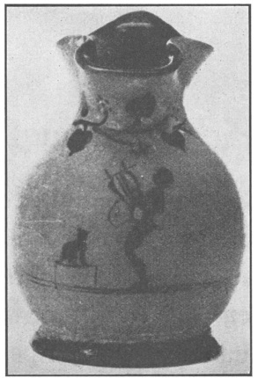
On a Boeotian toy oinochoe a boy plays the lyre for the amusement of his cat that sits on a small stool
and listens attentively. Antikensammlung, Berlin.
Other Companion Animals
Snakes
“As a drinking and living companion he [Ajax] had a tame snake that was five cubits long, which led
the way when he traveled and otherwise followed him like a dog” (Philostratus, Heroicus 31.3).
Hares/Rabbits
Roman politician and writer Julius Caesar (100-March 15, 44 BCE) tells us that the Britanni (ancestors of
the English) did not eat hare, goose, or chicken and instead raised these animals for pleasure.

Slide 45
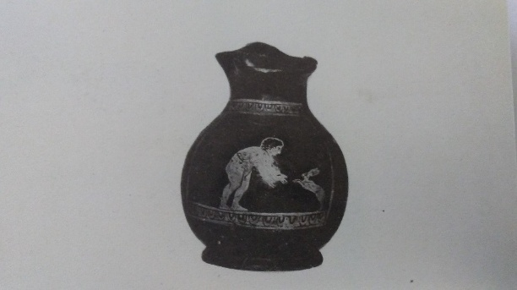
“They account it wrong to eat hare, fowl, and goose; but these they keep for pastime or pleasure”
(Caesar, Gallic Wars 5.2).
A boy, wearing a band of amulets around his body, holds out his arms to a hare which is standing on its
hind legs to greet its guardian. Ny Carlsberg Glyptotek, Copenhagen.

Slide 46
Fishes [sic]
Fishes as pets are described by Aelian:
“It seems that even fishes are both tame and tractable, and when summoned can hear and are
ready to accept food that is given them, like the sacred eel in the Fountain of Arethusa. And men tell
of the moray belonging to Crassus the Roman, which had been adorned with earrings and small
necklaces set with jewels, just like some lovely maiden; and when Crassus called it, it would recognize
his voice and come swimming up, and whatever he offered it, it would eagerly and promptly take and
eat. Now when this fish died Crassus, so I am told, actually mourned for it and buried it. And on one
occasion when Domitius said to him ‘You fool, mourning for a dead moray!’ Crassus took him up with
these words: ‘I mourned for a moray, but you never mourned for the three wives you buried” (Aelian,
On the Nature of Animals 8.4[i]).
“Tame fishes which answer to a call and gladly fish of various lands accept food are to be found and
are kept in many places, in Epirus for instance, at the town, formerly called Stephanepolis, in the
temple of Fortune in the cisterns on either side of the ascent; at Helorus too in Sicily which was once
a Syracusan fortress; and at the shrine of Zeus of Labranda in a spring of transparent water. And
there fish have golden necklaces and earrings also of gold…And in Chios in what is called
‘The Old Men’s Harbor’ there are multitudes of tame fish, which the inhabitants of Chios keep
to solace the declining years of the very aged” (Aelian, On the Nature of Animals 12.30).

Slide 47
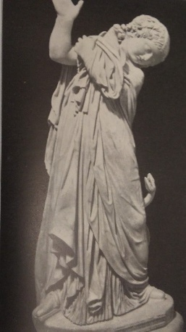
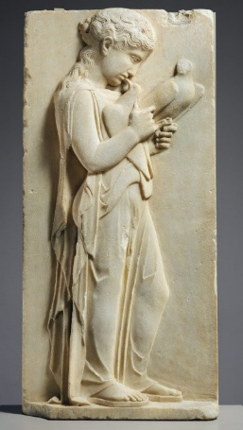
Pigeons
This Greek life-size Hellenistic marble statue features a young girl holding her pet pigeon away from
her pet snake to protect it. Capitoline Museums, Rome.

Slide 48
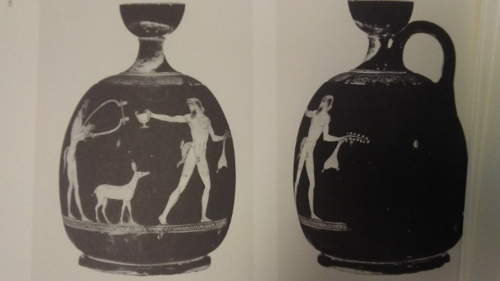
A famous Greek marble stele at the Metropolitan Museum of Art in New York features a girl kissing her
pet pigeon, ca. 450-440 BCE.
Animals as Gifts in Courtship
Animals such as hares and rabbits, fawns, doves, dogs, roosters were given in courtship as often
depicted in Greek art whether the couples were mythological creatures or real, whether of the
same or opposite sex.
A fawn as a “love gift” between two males. Attic red-figure skyphos (wine cup), ca. 460-450 BCE.
The Louvre Painter. Antikensammlung, Berlin.

Slide 49
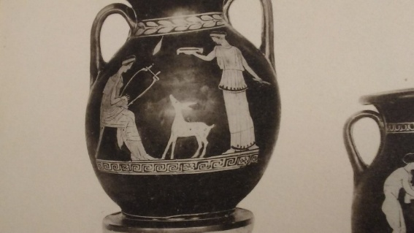
A fawn as a “love gift” between two females. Attic red-figure pelike (liquid container), ca 450-400 BCE.
Ny Carlsberg Glyptotek, Copenhagen.
Wild Animals
Foxes
Foxes were wild and often considered a nuisance for wine growers because they liked eating the vines.
chickens were not kept as often in antiquity as now, so we do not hear much about foxes killing chickens.
Greek biographer and essayist Plutarch (ca. 46-120 CE) tells of a Spartan boy who stole a young fox and
concealed it under his garments. The fox bit the boy who, out of fear of being discovered, quietly
endured the pain and died:
“The boys make such a serious matter of their stealing, that one of them, as the story goes, who was
carrying concealed under his cloak a young fox which he had stolen, suffered the animal to tear out
his bowels with its teeth and claws, and died rather than have his theft detected” (Plutarch, Lycurgus
18.51).

Slide 50
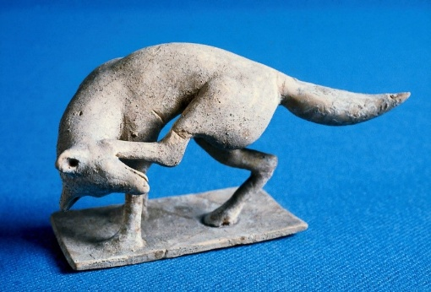
Children in Sparta, during rites of passage ceremonies, fasted almost to the point of starvation and were
supposed to steal to fill their bellies. During this phase of the ceremonies at the Artemis Orthia sanctuary
in Sparta, the children were referred to as foxes. At other Greek temples dedicated to Artemis girls
(possibly boys, too) in rites of passage rituals were called bears and fawns, and the priestesses in the
Artemis Temple at Ephesus bees and the priests drones. Artemis was the Greek goddess of animals,
especially wild, and of all of nature.
Terracotta figurine of a fox scratching its head. Tanagra, Greece, ca. 5th century BCE. Museum of
Fine Arts, Boston.
Rats and Mice
Rats and mice were considered pests also in antiquity and were even eaten; however, as with
everything in antiquity related to animals, there were contradictions. Mice were also worshiped as
the sacred animal of the god Apollo Smintheus, the Mouse-God; his cult statues showed him with a
mouse and a mouse is also featured on the coins of the town of Hamaxitus in the Troad in modern
Turkey where Apollo Smintheus’s main temple was situated.

Slide 51
Greek historian and geographer Strabo (ca. 64/63 BCE-24 CE) on the temple of Apollo, the Mouse-God:
“In this Chrysa is also the temple of Sminthian the symbol which preserves the etymology of the name,
Ι mean the mouse, lies beneath the foot of his image. These are the works of Scopas of Paros; and also
the history, or myth, about the mice is associated with this place: When the Teucrians arrived from
Crete (Callinus the elegiac poet was the first to hand down an account of these people, and many
have followed him), they had an oracle which bade them to “stay on the spot where the earth-born
should attack them”; and, he says, the attack took place round Hamaxitus, for by night a great
multitude of field-mice swarmed out of the ground and ate up all the leather in their arms and
equipment; and the Teucrians remained there; and it was they who gave its name to Mt. Ida, naming
it after the mountain in Crete. Heracleides of Pontus says that the mice which swarmed round the
temple were regarded as sacred, and that for this reason the image was designed with its foot upon
the mouse” (Strabo, Geography 13.1.48).
Mice lived and were fed at public expense in Apollo Smintheus’s temples. Herodotus tells a story in
which the Pharaoh Sethos was saved from an Assyrian invading army when a group of mice ate their
shield-handles, bowstrings, and quivers overnight (Herodotus 2.141).

Slide 52
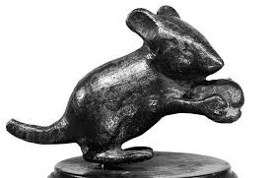
Bronze figurine of a mouse dedicated to Apollo Smintheus (the Mouse God). (Staatliche Museen zu
Berlin) Antikensammlung, Berlin.
The Rat is worshiped in today’s India where thousands of rats live and are fed in the Temple of Karni
Mata at Deshnoke in Rajasthan. Sacred rats and mice have also been found in tombs of women
from Neolithic Çatal Höyük in present-day Turkey to female warrior graves in Southern Ukraine.

Slide 53
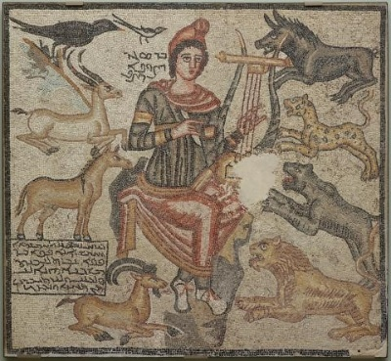
There are several ancient descriptions of animals being enticed by music. The story about the
legendary poet and prophet from Thrace (today bordering Bulgaria, Greece, Turkey), Orpheus, and
the many wild animals that came to listen to him playing the lyre (made from turtles’ shells) was
popular already in antiquity.
“Orpheus Taming Wild Animals.” Mosaic. Eastern Roman Empire, near Edessa. 194 CE. Dallas Museum of
Art.

Slide 54
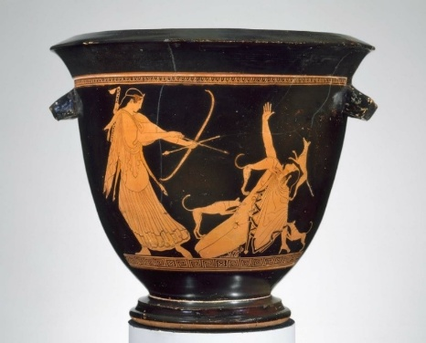
Hunting as Displays of Manhood
Deer
Of the story about Alcaeus, there are many versions. A children’s cartoon on American TV a couple of
years ago, featured the story of the goddess Artemis and the hunter Actaeon, loosely based on Ovid’s
tale in the Metamorphoses. This version described how the Greek goddess Artemis transformed the
hunter Actaeon into a stag to teach him a lesson about not killing animals. The terrified Actaeon,
now a deer, attempts to speak but is not able to make himself understood without a human language.
As his hunting companions are poised to throw their spears and shoot their arrows and the hunting
dogs are about to pounce at the “deer” Actaeon, he promises Artemis that if she would only change
him back into human form, he would never kill another living being and instead educate his hunting
companions about the plight and suffering of hunted animals, which was indeed the happy outcome.
Artemis shooting at Actaeon with his own hunting dogs attacking, seeing him as a deer. Bell krater to
mix water and wine by the so-called Pan Painter, ca. 470 BCE. Museum of Fine Arts, Boston.

Slide 55
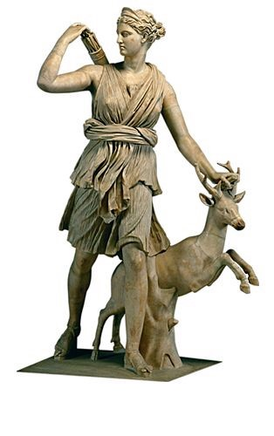
Deer were hunted then as now for “sport” or rather for “tests of manhood.” However, the gentle deer
were also sacred; in antiquity as the special companions of the goddess Artemis/Diana, but also as
gods in their own right among the Celts and other ancient peoples.
“
Artemis and a Stag.” European female (roe) deer may sometimes also sport antlers, so it could be
a doe. Roman copy of a sculpture by Greek artist Leochares from ca. 325 BCE. Louvre.

Slide 56
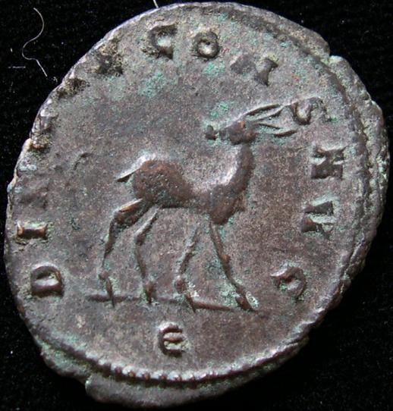
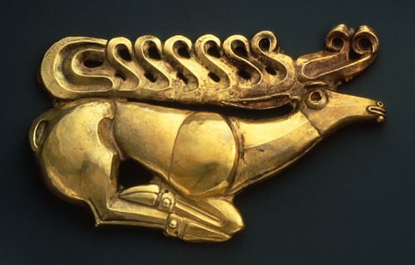
Artemis’/Diana’s deer on a Roman billon Antoninianus, from the reign of Emperor Gallienus,
ca. 267/268 CE. DIANAE CONSERVATORI AVGVSTI (to Diana (Artemis), the Preserver of the Emperor).
A Scythian fibula (broch) in the shape of a deer. Northern Caucasus. Made of gold, late 7th century
BCE. Hermitage, Saint Petersburg.

Slide 57
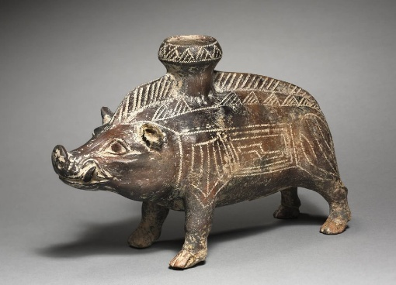
Wild boars, too, were hunted, especially among the Etruscans. However, hunting in classical Greece
seems mostly to have been an activity among upper class young males for “sport” or “proof of
manhood” rather than among farmers or workers for food, so the number of animals hunted in
antiquity would have been much smaller than today.
Etruscan perfume bottle in the figure of a boar, ca. 600-500 BCE. Cleveland Museum of Art, Ohio.

Slide 58
On the Emotions of Animals
The profound sadness some animals feel at the loss of a friend was nicely captured by Aelian:
“Now the purple coot, in addition to being extremely jealous, has, I believe, this peculiarity; they
say that it is devoted to its own kin and loves the company of its mates. At any rate I have heard
that a purple coot and a cock were reared in the same house that they fed together, that they
walked step for step, and that they dusted in the same spot. From these causes there sprang up a
remarkable friendship between them. And one day on the occasion of a festival their master
sacrificed the cock and made a feast with his household. But the purple coot, deprived of its
companion and unable to endure the loneliness, starved itself to death” (Aelian, On Animals 5.28).

Slide 59
A cow mother’s intense love for her calf was faithfully described by Roman poet and philosopher
Lucretius (ca. 99-55 BCE):
“For often in front of the noble shrines of the gods a calf falls slain beside the incense-burning altars,
breathing up a hot stream of blood from his breast; but the mother bereaved wanders through the
green glens, and seeks on the ground the prints marked by the cloven hooves, as she surveys all the
regions if she may espy somewhere her lost offspring, and coming to a stand fills the leafy woods with
her moaning, and often revisits the stall, pierced with yearning for her calf; nor can tender willow-growths,
and herbage growing rich in the dew, and those rivers flowing level with their banks, give delight to her mind and rebuff her sudden care, nor can the sight of other calves in the happy pastures divert her
mind and lighten her load of care: so persistently she seeks for something of her own that she knows
well” (Lucretius, De Rerum Natura 352-366).
On the Intelligence of Animals
Several ancient authors commented on the intelligence of various animal species.
For example, the intelligence of cows and baboons in Aelian’s On the Nature of Animals 7.1 and
6.10(i) and in Plutarch’s On the Intelligence of Animals 974d-e; the intelligence of the mule in
Plutarch (970a-b), Ants (967d-968b), crows, crocodiles, elephants, partridges, deer, fish such as
mullets, and cranes, tortoises, dolphins, horses.

Slide 60
Aelian on baboons that dance and play instruments:
“Under the Ptolemies the Egyptians taught baboons their letters, how to dance, how to play the flute
and the harp. And a baboon would demand money for these accomplishments, and would put
what was given him into a bag which he carried attached to his person, just like professional beggars”
(Aelian, On the Nature of Animals, 6.10[i]).
Plutarch on the intelligence of ants:
“A matter obvious to everyone is the consideration ants show when they meet: those that bear no
load always give way to those who have one and let them pass. Obvious also is the manner in which
they gnaw through and dismember things that are difficult to carry or to convey past an obstacle, in
order that they may make easy loads for several” (Plutarch, On the Intelligence of Animals 967f).
“But what goes beyond any other conception of their intelligence is their anticipation of the
germination of wheat. You know, of course, that wheat does not remain permanently dry and stable,
but expands and lactifies in the process of germination. In order, then, to keep it from running to seed
and losing its value as food, and to keep it permanently edible, the ants eat out the germ from
which springs the new shoot of wheat” (968a).

Slide 61
Animals do not need mnemonic devices
“Animals retain the memory of their experiences and have no need of those mnemonic systems
devised by Simonides, by Hippias, and by Theodectes, or by any other of those who have been
extolled for their profession and their skill in this matter. For instance, a cow goes to the spot where
her calf was taken from her and mourns for it, lowing as is her wont” (Aelian, On the Nature of
Animals 6.10[ii]).
Greco-Roman poet Oppian in treatises on fishing details the intelligence of Fish – Cuttle Fish, Prawn,
Crab, Grey Mullet, Muraena, Bass, etc. (Oppian, Halieutica 2.120; 2.169; 3.92-188; 4.40-64).
Oppian (2nd century CE) on the intelligence of fish:
“Fish employ cunning wit and deceitful craft and often deceive even the wise fishermen themselves
and escape from the might of hooks and from the belly of the trawl when already caught in them and
outrun the wits of men; outdoing them in craft and become a grief to the fishermen” (Oppian,
Halieutica 3.92-98).

Slide 62
Roman naturalist author Pliny the Elder (23-79 CE) on the intelligence of elephants:
“The elephant is the largest of them all, and in intelligence approaches the nearest to man. It
understands the language of its country, it obeys commands, and it remembers all the duties which
it has been taught. It is sensible alike of the pleasures of love and glory, and, to a degree that is rare
among men even, possesses notions of honesty, prudence, and equity; it has a religious respect also
for the stars, and a veneration for the sun and the moon” (Pliny, Natural History 8.1.).
Cruelty towards Animals in Antiquity
The use and exploitation of animals and human cruelty and deception towards them are poignantly
recounted in this ancient Egyptian allegory on a Demotic papyrus in Leiden:

Slide 63
“…One day it happened that he [a lion] met a panther whose fur was stripped, whose skin was torn,
who was half dead and half alive [because of his] wounds. The lion said: How did you get into this
condition? … The panther said: “It was man.” The lion said to him: Man, what is that?” The panther
said: “There is no one more cunning than man. May you not fall into the hands of man!” The lion
became enraged against man. He ran away from the panther in order to search for [man]. The lion
encountered a team yoked […] […] so that one bit was in the mouth of the horse, the other bit [in the]
mouth of the donkey. The lion said to them: “Who is he who has done this to you?” They said: “It is man,
our master.” He said to them: “Is man mightier than you?” They said: …There is no one more cunning
than man. May you not fall into the hand of man” The lion became enraged against man. He ran
away from them.”
“The same happened to him with an ox and a cow, whose horns were clipped, whose noses were
pierced, and whose heads were roped. He questioned them. They said the same. The same thing
happened with a bear whose claws had been removed and whose teeth had been pulled. He asked
them, saying: “Is man stronger than you?” He said: “That is the truth. I had a servant who prepared my
food. He said to me: “Truly, your claws stick out from your flesh; you cannot pick up food with them.
Your teeth protrude; they do not let food reach your mouth. Release me and I will cause you to pick
up twice as much food!” When I released him, he removed my claws and my teeth. I have no food or
strength without them! He strewed sand in my eyes and ran away from me. The lion became enraged
against man. He ran away from the bear in order to search for man.”

Slide 64
“He met a lion who was [tied to] a tree of the desert, the trunk being closed over his paw and he
was very distressed because he could not run away. The lion said to him: “How did you get into this
evil condition? Who is he who did this to you?” The lion said to him: “It is man. Beware, do not trust
him! Man is bad. Do not fall into the hand of man!” I had said to him: “What work do you do?” He
said to me: “My work is giving old age. I can make for you an amulet, so that you will never die.”
I went with him. He came to this tree of the mountain, sawed it, and said to me: “Stretch out your
paw.” I put my paw between the trunk; he shut its mouth on it. When he had ascertained that my
paw was fastened, so that I could not run after him, he strewed sand into my eyes and ran away
from me. Then the lion laughed and said: “Man if you should fall into my hand, I shall give you the
pain that you inflicted on my companion on the mountain!” (I 384).

Slide 65
Conclusion
In ancient Mesopotamia and Egypt many animals were sacred and well-treated. In Greece and
Rome, too, animals could be sacred to gods and goddesses and pets, especially dogs, could receive
their own burials with tombstones honoring them. And even though animals were eaten, plant protein
was still the staple and there were no factory farms as today with more than 90 billion animals
slaughtered each year. Even though there were the occasional individual such as the Greek
philosopher Aristotle (384–322 BCE) and, later in antiquity, physicians such as the Greek Galen
(129–ca. 210 CE) who performed dissections and vivisections to study animal anatomy and physiology,
it cannot compare to the more than 100 million animals currently being killed throughout the world
each year in today’s laboratories. And with a much smaller human population, habitat loss was
minimal compared to today and man-made climate change was not yet an issue. The greatest
challenges non-human animals faced in antiquity were animal sacrifice and the imperial Roman
penchant for staging wild animal “fights” in the arena. As difficult as life for many animals was in
antiquity, several of the ancient narratives and pleas on behalf of nonhuman animals reveal a
passion for animals and animal welfare, even animal rights sentiments, among some ancient
individuals, echoed by contemporary animal rights advocates.

Slide 66
Select Bibliography
Aelian. De Natura animalium. On the characteristics of animals; Greek and English with an English
translation by A.F. Scholfield. Cambridge: Harvard University Press, 1958-1959.
Albertus Magnus. De animalibus. On Animals: A Medieval Summa Zoologica, translated and
annotated by Kenneth F. Kitchell, Jr., & Irven Michael Resnick. Baltimore: Johns Hopkins University Press,
1999.
Aristotle’s Generation of Animals: A Critical Guide. Andrea Falcon and David Lefebvre (eds.).
Cambridge University Press, 2018.
Brewer, Douglas J., Donald B. Redford, and Susan Redford. Domestic Plants and Animals: The
Egyptian Origins. Warminster, England: Aris & Phillips, 1994.
Calder, Louise. Cruelty and sentimentality: Greek attitudes to animals, 600-300 BC. Oxford:
Archaeopress, 2011.
Chiens et chats dans la préhistoire et l’antiquité. Claire Bellier, Laureline Cattelain & Pierre Cattelain
(eds.). Treignes: Éditions du Cedarc, 2015.
Collins, Billie Jean. A History of the Animal World in the Ancient Near East. Leiden; Boston: Brill, 2002.

Slide 67
De l’aigle à la louve: Monnaies et gemmes antiques entre art, propagande et affirmation de soi.
Matteo Campagnolo and Carlo-Maria Fallani (eds.). Geneva: Musée d’art et d’histoire de Genève,
2018.
Ferris, Iain. Cave Canem: Animals and Roman Society. Gloucestershire: Amberley, 2018.
Gilhus, Ingvild Sælid. Animals, Gods and Humans: Changing Attitudes to Animals in Greek, Roman and
Early Christian Ideas. London; New York: Routledge, 2006.
Harden, Alastair. Animals in the Classical World: Ethical Perspectives from Greek and Roman Texts.
Houndmills, Basingstoke, Hampshire; New York: Palgrave Macmillan, 2013.
Interactions Between Animals and Humans in Graeco-Roman Antiquity. Thorsten Fögen and Edmund
Thomas (eds.). Berlin; Boston: Walter de Gruyter, 2017.
Kitchell, Jr., Kenneth F. Animals in the Ancient World from A to Z. Abingdon, Oxon: Routledge, 2014.
Korhonen, Tua and Erika Ruonakoski. Human and Animal in Ancient Greece: Empathy and Encounter
in Classical Literature. London; New York, NY: I.B. Tauris & Co. Ltd, 2017.
Llewellyn-Jones, Lloyd. The Culture of Animals in Antiquity: A Sourcebook with Commentaries. Milton
Park, Abingdon; New York, NY: Routledge, 2017.

Slide 68
Lonsdale, Steven. Animals and the Origins of Dance. New York, N.Y.: Thames and Hudson, 1982, 1981.
Mensch und Tier in der Antike: Grenzziehung und Grenzüberschreitung : Symposion vom 7. bis 9.
April in Rostock. Annetta Alexandridis, Markus Wild und Lorenz Winkler-Horacek (eds.). Wiesbaden:
Reichert Verlag, 2008.
Mynott, Jeremy. Birds in the Ancient World. Oxford: Oxford University Press, 2018.
Newmyer, Stephen T. Animals in Greek and Roman Thought: A Sourcebook. London; New York:
Routledge, 2011.
Plato's Animals: Gadflies, Horses, Swans, and other Philosophical Beasts. Jeremy Bell and Michael
Naas (eds.). Bloomington and Indianapolis: Indiana University Press, 2015.
Plutarch's Three Treatises on Animals: A translation with introductions and commentary by Stephen
T. Newmyer. Abingdon, Oxon; New York, NY: Routledge, 2021.
Porphyry. De abstinentia. On abstinence from killing animals; translated by Gillian Clark. Ithaca, N.Y.:
Cornell University Press, 2000.

Slide 69
Richter, Gisela. Animals in Greek Sculpture, a Survey. New York; Oxford University Press, 1930.
Sagiv, Idit. Representations of Animals on Greek and Roman Engraved Gems: Meanings and
Interpretations. Oxford: Archaeopress, 2018.
Smith, Steven D. Man and Animal in Severan Rome. Cambridge: Cambridge University Press, 2014.
Speaking Animals in Ancient Literature. Hedwig Schmalzgruber (ed.). Heidelberg: Universitätsverlag
Winter, 2020.

